Slide 1

Presentation to Data Transparency
Town Hall
Daniel Dudis
Senior Policy Director
September 26, 2014

Slide 2
Fiscal Transparency – the Civil Society Perspective
Essential to promoting informed public participation
A specific goal in the US’s second action plan under the Open Gov. Partnership
A valuable tool for Congress, agencies, and oversight bodies interested in monitoring federal spending
A valuable tool for civil society interested in monitoring spending, particularly procurements and grants

Slide 3
Fiscal Transparency – the link with procurement monitoring
USG total procurement spend over $500 billion annually
OECD estimates that worldwide, 20-25% of procurement spend lost to corruption
Civil society seeks to reduce corruption and fraud through procurement monitoring
Two types of civil society procurement monitoring to identify procurement corruption and fraud: macro and micro

Slide 4
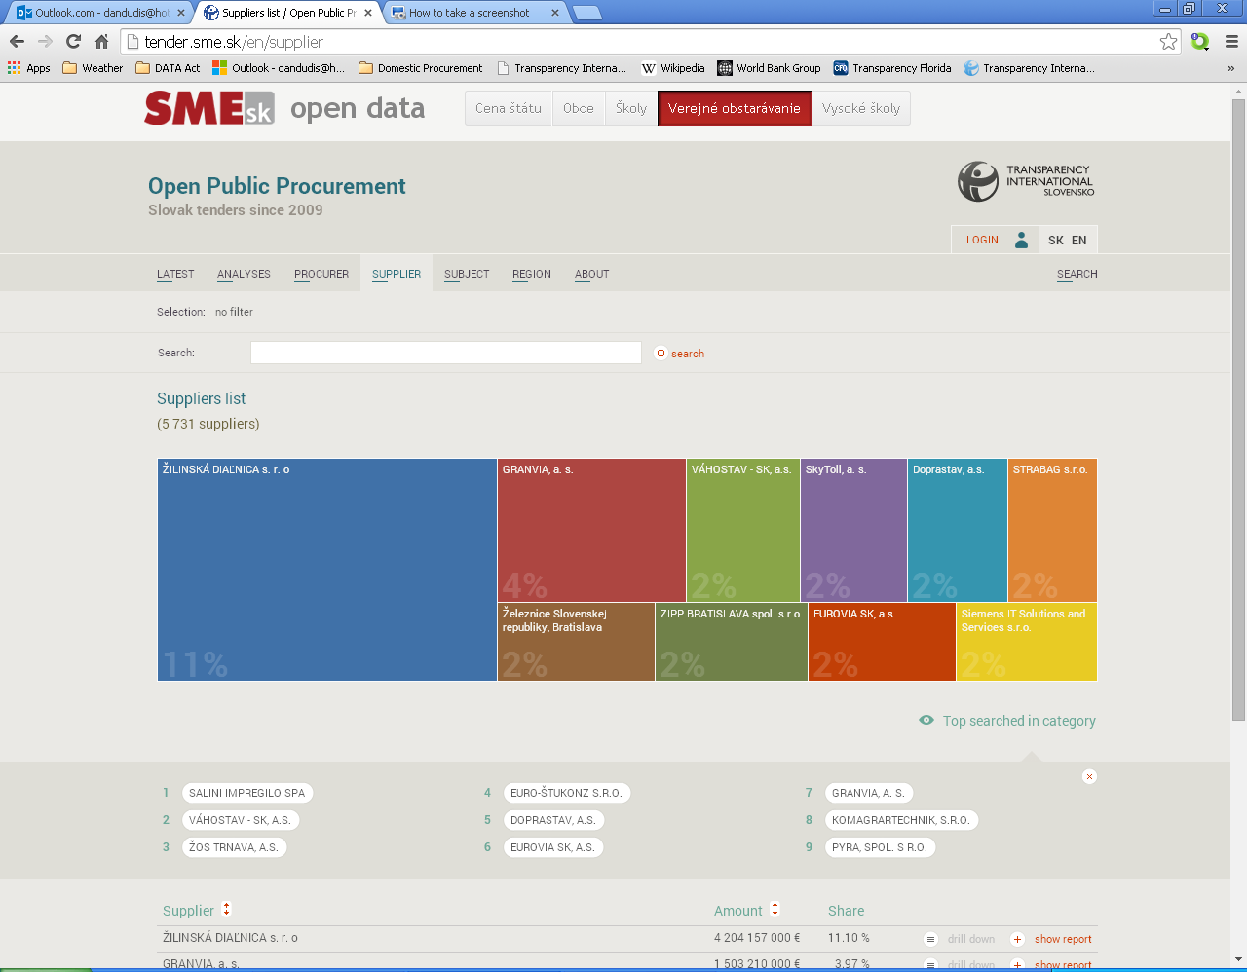
Macro approach: relies on data analysis to spot patterns
Largest contractors

Slide 5
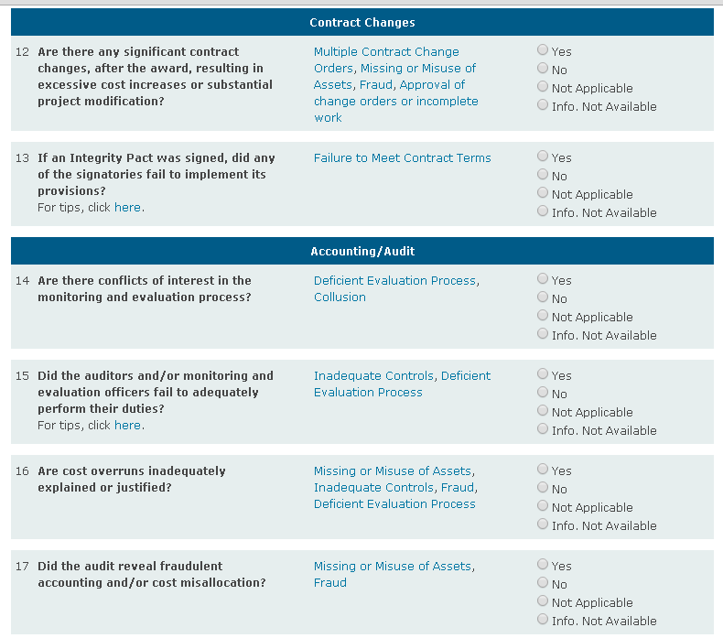
Micro approach: relies on detailed monitoring of individual procurements

Slide 6
The DATA Act: How can it help civil society procurement monitoring?
Macro approach depends upon:
Open, non-proprietary format
Machine-readable
Downloadable in bulk
Macro approach also depends upon unique identifiers for parent company and subsidiaries/offices
Ultimate beneficial ownership information must also be disclosed

Slide 7
The DATA Act: How can it help civil society procurement monitoring?
Current reliance on DUNS numbers must be ended
DUNS numbers are proprietary—when government doesn’t pay for the right to use them, the data disappears
DUNS numbers are also assigned to subsidiaries, offices, etc. – very difficult to aggregate information for large corporate groups

Slide 8
The DATA Act: How can it help civil society procurement monitoring?
Micro approach depends upon checkbook-level payment detail
Checkbook-level payment detail allows civil society monitors to track execution and payment of contracts
www.checkbooknyc.com is a good example of a site with the type of information useful to civil society monitors

Slide 9
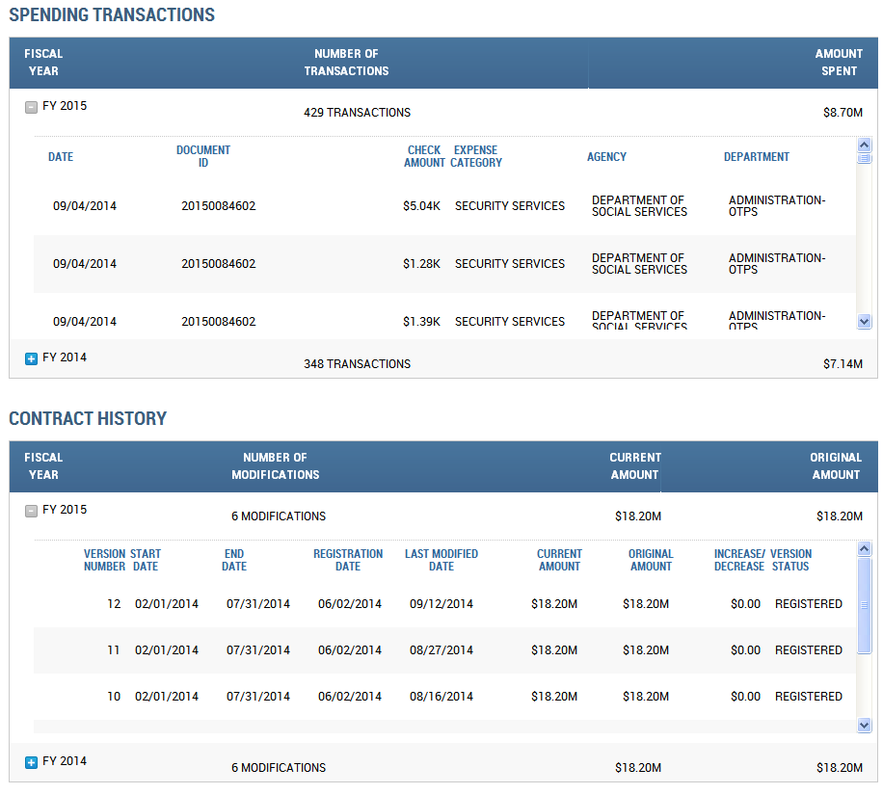
The NYC Checkbook example

Slide 10
Keys to DATA Act success
Non-proprietary, machine readable identifiers
Unique identifiers for corporate parent and office/subsidiary
Checkbook-level spending detail
User-friendly, public-oriented website
Excellent management and oversight necessary to ensure timeliness, completeness, and accuracy of spending data

Slide 11
Thank You
Comments and questions welcome!
ddudis@transparency-usa.org

